Slide 1
Ishikawa Diagram
Also known as Fishbone Diagram or Cause and Effect Analysis

Slide 2
What is it?
AKA – FISHBONE DIAGRAM
CREATED BY DR. KAORU ISHIKAWA
Japanese QC statistician in the 1960’s
QUALITY IMPROVEMENT TOOL
CAUSE-AND-EFFECT DIAGRAM
PROBLEM SOLVING TOOL
Systematic way
Big / High Level Problems
Behavioral as well as Technical
Also used for smaller problems.

Slide 3
Looks Like…
CAUSE
EFFECT
Secondary
Cause
Primary
Cause
The
PROBLEM
Categories

Slide 4
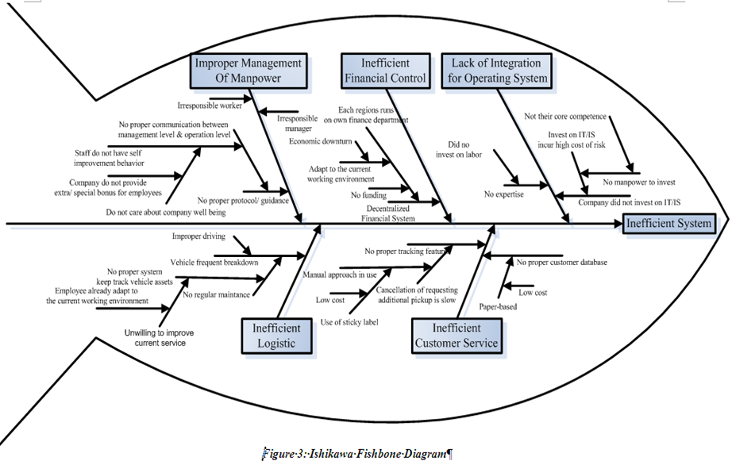
Called Fishbone because…
Looks a bit like the fish’s skeleton

Slide 5
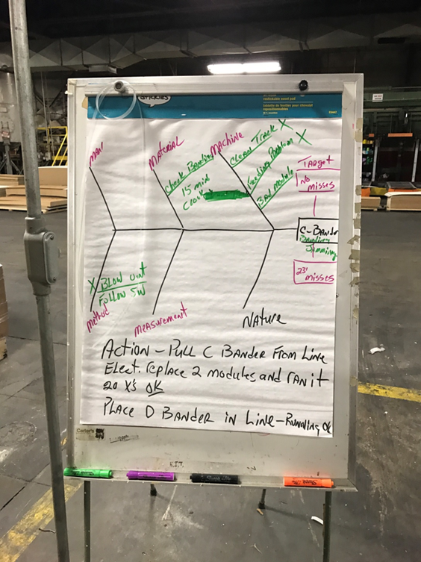
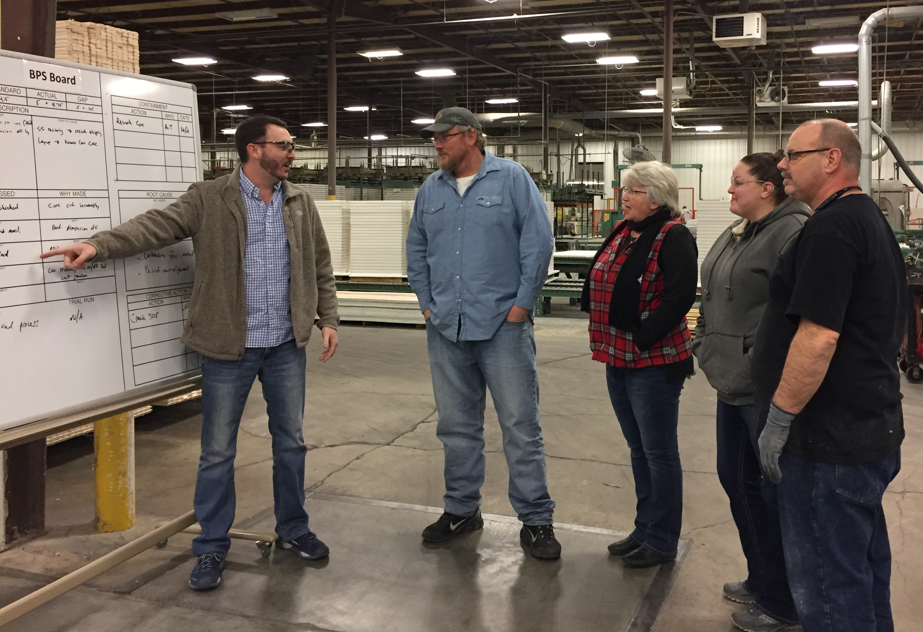
Purpose
Cause and Effect Analysis is used to identify the causes, factors, and sources of variation that lead to a specific results, event, or defect in a process or product
(Identify what is causing a performance problem)
Grouping into categories (branches), helps organize and identify potential causes
Graphically displays relationship between causes and their effect.
Tool that is used along with 5 why and Brainstorming

Slide 6
Advantages / Disadvantages
ADVANTAGES
Permits a thoughtful analysis that avoids overlooking any possible root causes for a need.
Easy to implement and creates an easy-to-understand visual representation of the causes, categories of causes, and the need.
Focuses the group on the “big picture” as to possible causes or influencing factors of the problem/need
Even after the need has been addressed, the fishbone diagram shows areas of weakness that can be rectified before causing more sustained difficulties.
DISADVANTAGES
Can make it difficult to represent the truly interrelated nature of problems and causes in some very complex situations.
If not given enough space to draw fishbone, you may find you are not able to explore the cause and effect relationships in as much detail as you would like to.

Slide 7
How to use it?
Define the effect. Be specific about the problem
Choose the categories
Most common set → Man (People); Machine (Equipment); Process (Method); Material; Environment; Management
Brainstorming possible causes
Ask Why?
And Why Else?...
Using diagram helps broaden and focus thinking

Slide 8
Types of Causes
Don’t forget that there are multiple causes.
Primary Cause → leads directly to the effect
Secondary Cause → leads to primary, but does not directly cause and effect
Material
Machine
Man
Slippery hands
Dropping
throwing
roll off table
Light bulbs burn
out prematurely
Method
Environment
Management

Slide 9
How to use it? (Cont.)
DETERMINE IS ROOT CAUSE
Ask the following questions:
Would problem have occurred if this cause was not present?
Would problem re-occur if cause was corrected?
If answer NO to both questions, circle cause
INVESTIGATE
Gather data to confirm if real or not (if you do not have already)
Pick main 5 probable causes based on data – and rank them
Eliminate them. Have an action plan to track
Validate if the effect changed as you would have expected

Slide 10
Example
CAUSE
EFFECT
People (Shooter)
Material (Ball)
Method (Shooting Mechanism)
Aiming Point
Concentration
Grain/Feel (Grip)
Conditioning
Bend Knees
Consistency
Motivation
Air Pressure
Size of Ball
Hand Position
Balance
Training
Lopsidedness
Follow-Through
Adjustment to Other Variables
Missed Free-Throws
Rim Size
Rim Height
Wind Gusts/Sun/Rain
Rim “Play”
- Tightness
Rim Alignment
Open Air
Environment
Backboard Stability
Environment (Weather)
Machine (Hoop & Backboard)

Slide 11
What did they find?
CAUSE
EFFECT
People (Shooter)
Material (Ball)
Method (Shooting Mechanism)
Aiming Point
Concentration
Grain/Feel (Grip)
Conditioning
Bend Knees
Consistency
Motivation
MC
Air Pressure
Size of Ball
Hand Position
Balance
Training
Lopsidedness
Follow-Through
Adjustment to Other Variables
Missed Free-Throws
Rim Size
Rim Height
Wind Gusts/Sun/Rain
Rim “Play”
- Tightness
Rim Alignment
MC
Open Air
Environment
Backboard Stability
Root Cause Contributor
Environment (Weather)
Machine (Hoop & Backboard)
MC
Mathematical Correlation

Slide 12
Practice Time
Effect (Y)

Slide 13
Thank You

